Slide 1

Laboratory Work 1 Simple semiconductor device circuits design and simulation
Nikolai Poliakov (polyakov_n_a@itmo.ru)
Arina Arbuzina (arbyzina99@gmail.com)

Slide 2
Summary
LT Spice simulation for electronic device analysis
Diode parameters analysis
Rectifier scheme simulation
Capacitor parameter analysis
Overvoltage test
Starting current test
Uploading report to the

Slide 3
Goal and tasks
The goal of laboratory work «Simple semiconductor device circuits design and simulation» is to study rectifier scheme on the basis of proposed diode.
Laboratory work task are:
Rectifier scheme simulation
Diode parameters analysis
Capacitor parameter analysis
Overvoltage check
Starting current check

Slide 4
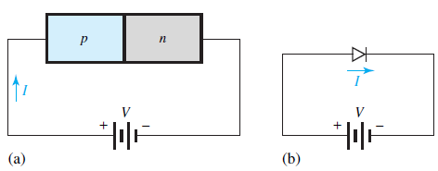
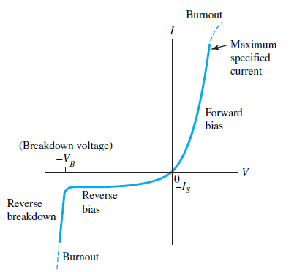
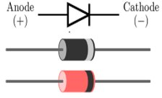
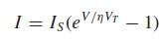
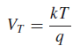
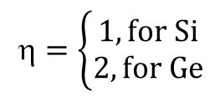
pn-junction under external voltage
the Boltzmann diode equation
$$=\left\{\begin{aligned}1, for Si \\ 2, for Ge\end{aligned}\right.$$

Slide 5
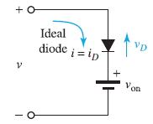
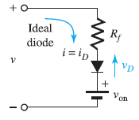
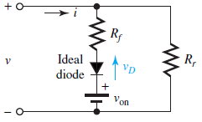
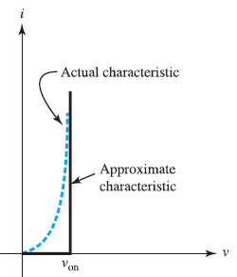
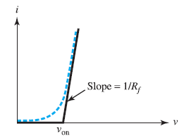
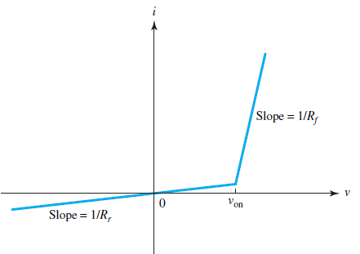
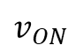
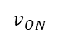
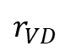
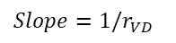
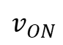
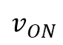

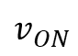
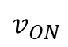

Forward-biased diode models
$$r_{VD}$$
$$r_{VD}$$
$$v_{ON}$$
$$v_{ON}$$
$$v_{ON}$$
$${Slope=1/r}_{VD }$$
$${Slope=1/r}_{VD }$$
$$v_{ON}$$
$$v_{ON}$$
$$v_{ON}$$

Slide 6
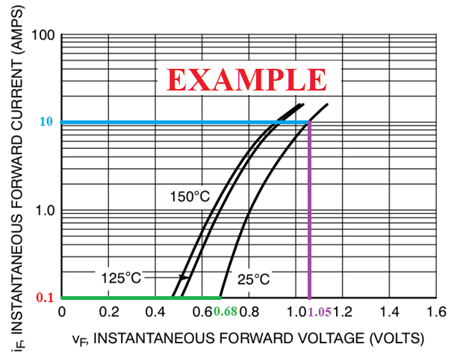
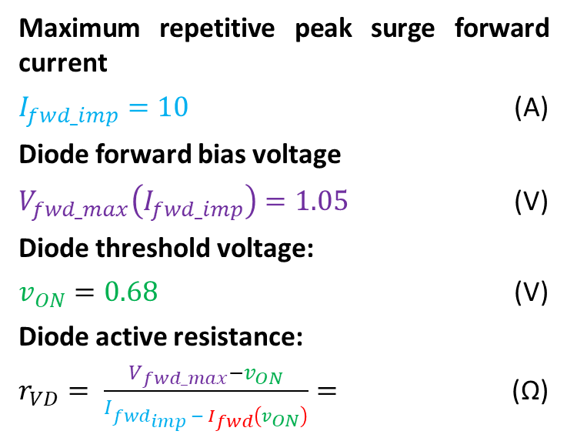
Diode active resistance
Maximum repetitive peak surge forward current
$I_{fwd_imp}=10$ (A)
Diode forward bias voltage
$V_{fwd_max}\left(I_{fwd_imp}\right)=1.05$ (V)
Diode threshold voltage:
$v_{ON}=0.68$ (V)
Diode active resistance:
$r_{VD}= \frac{V_{fwd_max}−v_{ON}}{I_{fwd_{imp} − I_{fwd}\left(v_{ON}\right)}}=$ (Ω)
Notes:
One of the main parameters of a diode is the Diode active resistance under forward bias. The easiest way to calculate the resistance of a diode is from its current-voltage characteristics. Consider the forward branch of the diode. Let's mark two points on it - voltage and current, at which the diode turns off and the maximum allowable repetitive peak surge forward current value and the corresponding voltage. The diode resistance will be calculated as the ratio of the voltage difference to the corresponding current difference.

Slide 7
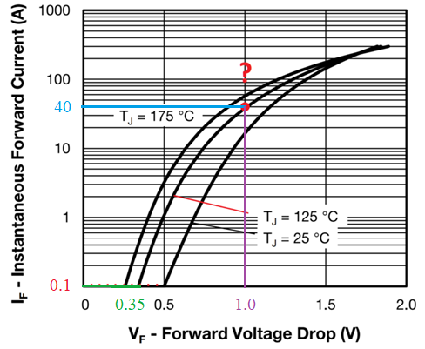
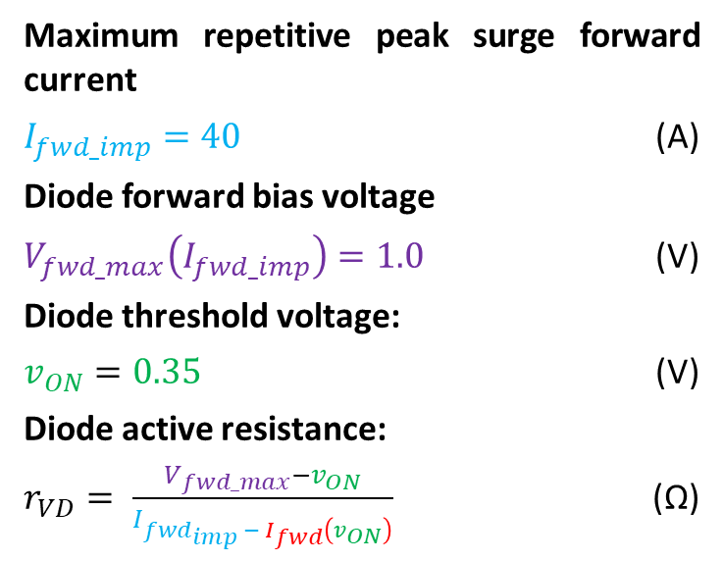
Diode active resistance
Maximum repetitive peak surge forward current
$I_{fwd_imp}=40$ (A)
Diode forward bias voltage
$V_{fwd_max}\left(I_{fwd_imp}\right)=1.0$ (V)
Diode threshold voltage:
$v_{ON}=0.35$ (V)
Diode active resistance:
$r_{VD}= \frac{V_{fwd_max}−v_{ON}}{I_{fwd_{imp} − I_{fwd}\left(v_{ON}\right)}}$ (Ω)
Notes:
let's check the correctness of the solution. Maximum repetitive peak surge forward current for our point is equals to 40 A. The diode forward bias voltage corresponding to this current is equal to 1 V. Diode threshold voltage for diode is equals to 0,35 V and corresponding current to 0,1 A. Substituting all the numbers in the formula, we get that the Diode active resistance is equal to 0.0163 Ohm
$r_{VD}= \frac{1−0.35}{40−0.1}=$ 0.0163 Ω

Slide 8
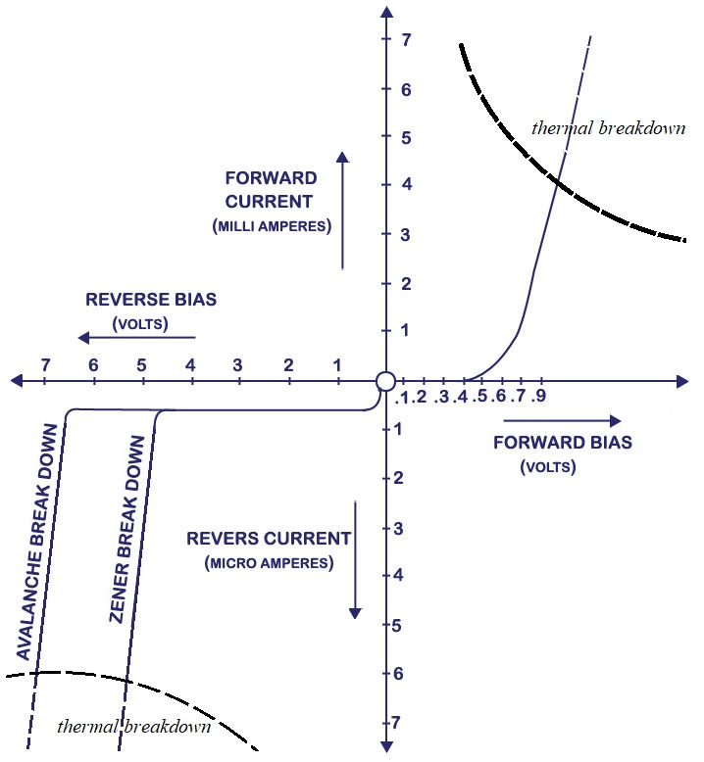
Diode breakdown
Diode breakdown
Reversible:
Zener breakdown (at low voltages)
Avalanche breakdown (at higher voltages)
Irreversible:
thermal breakdown
Zener and Avalanche breakdown find application in stabilitrons.
Notes:
The voltage at which the breakdown occurs is called the breakdown voltage.
Reverse breakdown occurs due to the following two mechanisms: Zener breakdown and Avalanche breakdown. Zener breakdown phenomena occurs in a pn junction diode with heavy doping & thin junction (depletion layer width is very small.
Avalanche breakdown occurs in a pn junction diode which is moderately doped and has a thick junction (means its depletion layer width is high).
The temperature coefficient of the Zener is negative and for Avalanche is positive.
Avalanche breakdown has a hysteresis effect; once breakdown has occurred, the material will continue to conduct even if the voltage across it drops below the breakdown voltage. This is different from a Zener diode, which will stop conducting once the reverse voltage drops below the breakdown voltage. The large voltage drop and possibly large current during breakdown necessarily leads to the generation of heat. If the generated heat exceeds the permissible heat dissipation power, the junction is destroyed. Thermal breakdown is present both on the reverse and on the forward branch of the I - V characteristic of the diode. Zener and Avalanche breakdown find application in stabilitrons.

Slide 9
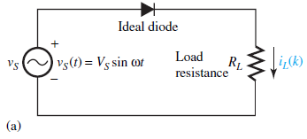
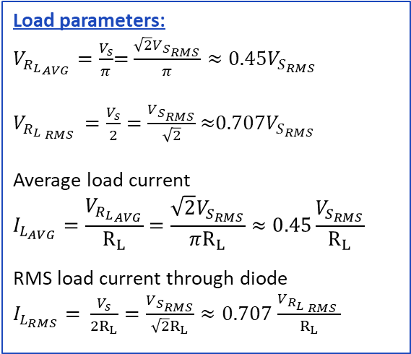
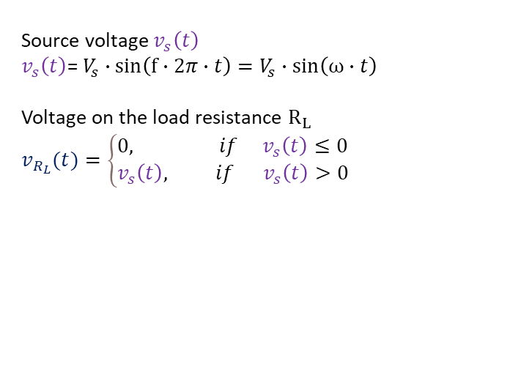
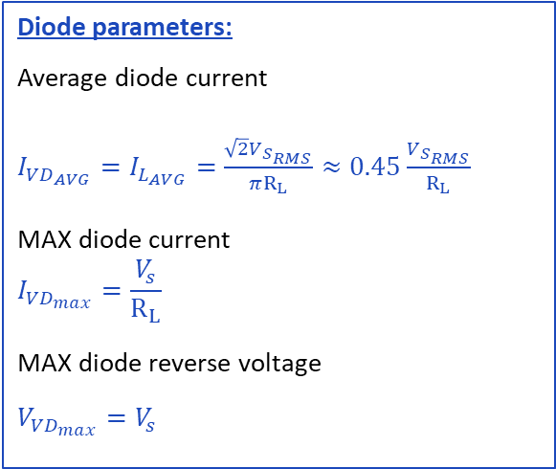
Half-Wave Rectifier (HWR)
Source voltage${ v}_{s}\left(t\right)$
$v_{s}\left(t\right)$= $V_{s}∙sin\left(f∙2π∙t\right)=V_{s}∙sin\left(ω∙t\right)$
Voltage on the load resistance $R_{L}$
$$v_{R_{L}}(t)=\left\{\begin{aligned}&0, if v_{s}\left(t\right)≤0 \\ &v_{s}\left(t\right), if{ v}_{s}\left(t\right)>0\end{aligned}\right.$$
Load parameters:
$V_{{R_{L}}_{AVG}}=\frac{V_{s}}{π}$= $\frac{{\sqrt{2}V}_{S_{RMS}}}{π}≈0.45V_{S_{RMS}}$
$V_{{R_{L}}_{ RMS }}=\frac{V_{s}}{2}=$ $\frac{V_{S_{RMS}}}{\sqrt{2}}$ $≈$0.707$V_{S_{RMS}}$
Average load current
$$I_{L_{AVG}}=\frac{V_{{R_{L}}_{AVG}}}{R_{L}}=\frac{{\sqrt{2}V}_{S_{RMS}}}{πR_{L}}≈0.45\frac{V_{S_{RMS}}}{R_{L}}$$
RMS load current through diode
$I_{L_{RMS}}=$ $\frac{V_{s}}{2R_{L}}=\frac{V_{S_{RMS}}}{\sqrt{2}R_{L}}≈\text{0.707}$ $\frac{V_{{R_{L}}_{ RMS }}}{R_{L}}$
Diode parameters:
Average diode current
$I_{{VD}_{AVG}}=I_{L_{AVG}}=$ $\frac{{\sqrt{2}V}_{S_{RMS}}}{πR_{L}}≈0.45\frac{V_{S_{RMS}}}{R_{L}}$
MAX diode current
$$I_{{VD}_{max}}=\frac{V_{s}}{R_{L}}$$
MAX diode reverse voltage
$$V_{{VD}_{max}}=V_{s}$$

Slide 10
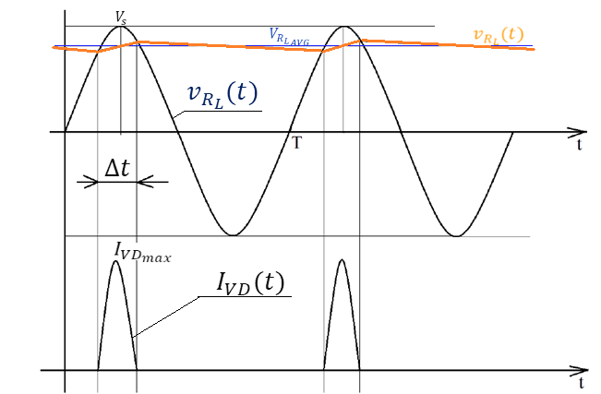
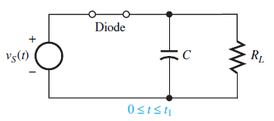
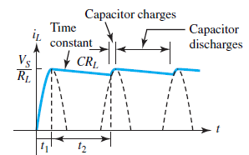
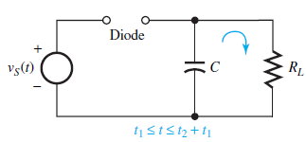
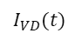
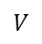
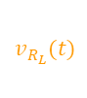
Half-Wave Rectifier with DC filter capacitor
$$V$$
$$v_{R_{L}}(t)$$
$$I_{VD}(t)$$

Slide 11
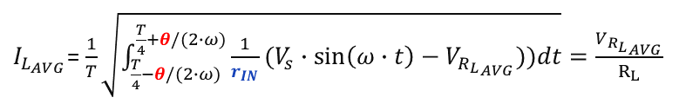
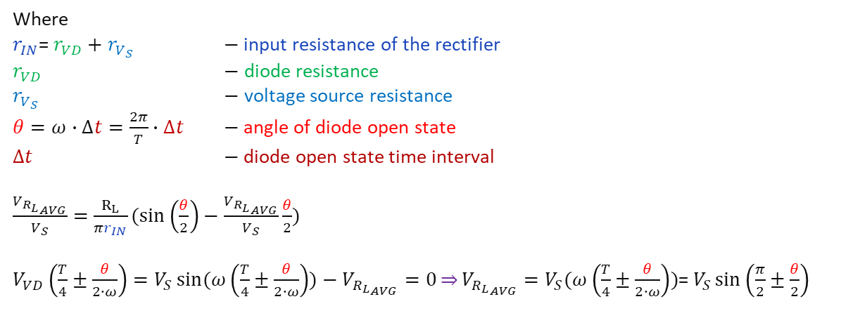
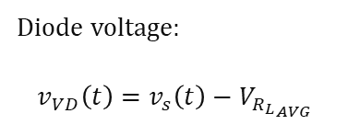
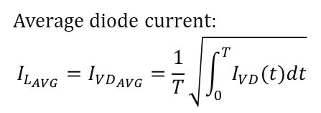
Half-Wave Rectifier with DC filter capacitor
$v_{R_{L}}(t)=$ $V_{{R_{L}}_{AVG}}$+ $v_{{R_{L}}_{\sim }}(t)≈V_{{R_{L}}_{}}$=const
$$V$$
Average diode current:
$$I_{L_{AVG}}=I_{{VD}_{AVG}}=\frac{1}{T}\sqrt{\int_{0}^{T}{I_{VD}(t)dt}}$$
$$v_{R_{L}}(t)$$
Diode voltage:
$$v_{VD}\left(t\right)=v_{s}\left(t\right)−V_{{R_{L}}_{AVG}}$$
$I_{L_{AVG}}$= $\frac{1}{T}\sqrt{\int_{\frac{T}{4}−θ/(2∙ω)}^{\frac{T}{4}+θ/(2∙ω)}{\frac{1}{r_{IN}}(V_{s}∙\sin\left(ω∙t\right)−V_{{R_{L}}_{AVG}}))dt}}=\frac{V_{{R_{L}}_{AVG}}}{R_{L}}$
$$I_{VD}(t)$$
Where
$r_{IN}$= $r_{VD}+$ $r_{V_{S}}$ $−$input resistance of the rectifier
$r_{VD}$ $−$ diode resistance
$r_{V_{S}}$ $−$ voltage source resistance
$θ=ω∙∆t=\frac{2π}{T}∙∆t$ $−$angle of diode open state
$∆t$ $−$diode open state time interval
$\frac{V_{{R_{L}}_{AVG}}}{V_{S}}=$ $\frac{R_{L}}{πr_{IN}}(\sin\left(\frac{θ}{2}\right)−\frac{V_{{R_{L}}_{AVG}}}{V_{S}}\frac{θ}{2})$
$V_{VD}\left(\frac{T}{4}±\frac{θ}{2∙ω}\right)=V_{S}\sin{(ω\left(\frac{T}{4}±\frac{θ}{2∙ω}\right))−V_{{R_{L}}_{AVG}}=0}\overset{⇒}{}V_{{R_{L}}_{AVG}}$ $=V_{S}(ω\left(\frac{T}{4}±\frac{θ}{2∙ω}\right))$= $V_{S}\sin\left(\frac{π}{2}±\frac{θ}{2}\right)$

Slide 12
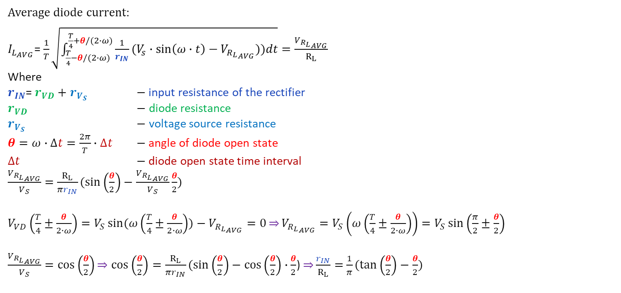
Half-Wave Rectifier with DC filter capacitor
$$V$$
$$v_{R_{L}}(t)$$
Average diode current:
$I_{L_{AVG}}$= $\frac{1}{T}\sqrt{\int_{\frac{T}{4}−θ/(2∙ω)}^{\frac{T}{4}+θ/(2∙ω)}{\frac{1}{r_{IN}}(V_{s}∙\sin\left(ω∙t\right)−V_{{R_{L}}_{AVG}}))dt}}=\frac{V_{{R_{L}}_{AVG}}}{R_{L}}$
Where
$r_{IN}$= $r_{VD}+$ $r_{V_{S}}$ $−$input resistance of the rectifier
$r_{VD}$ $−$ diode resistance
$r_{V_{S}}$ $−$ voltage source resistance
$θ=ω∙∆t=\frac{2π}{T}∙∆t$ $−$angle of diode open state
$∆t$ $−$diode open state time interval
$\frac{V_{{R_{L}}_{AVG}}}{V_{S}}=$ $\frac{R_{L}}{πr_{IN}}(\sin\left(\frac{θ}{2}\right)−\frac{V_{{R_{L}}_{AVG}}}{V_{S}}\frac{θ}{2})$
$V_{VD}\left(\frac{T}{4}±\frac{θ}{2∙ω}\right)=V_{S}\sin{(ω\left(\frac{T}{4}±\frac{θ}{2∙ω}\right))−V_{{R_{L}}_{AVG}}=0}\overset{⇒}{}V_{{R_{L}}_{AVG}}$ $=V_{S}\left(ω\left(\frac{T}{4}±\frac{θ}{2∙ω}\right)\right)=V_{S}\sin\left(\frac{π}{2}±\frac{θ}{2}\right)$
$\frac{V_{{R_{L}}_{AVG}}}{V_{S}}=\cos\left(\frac{θ}{2}\right)\overset{⇒}{}$ $\cos\left(\frac{θ}{2}\right)=\frac{R_{L}}{πr_{IN}}(\sin\left(\frac{θ}{2}\right)−\cos\left(\frac{θ}{2}\right)∙\frac{θ}{2}$) $\overset{⇒}{}\frac{r_{IN}}{R_{L}}=$ $\frac{1}{π}(tan\left(\frac{θ}{2}\right)−\frac{θ}{2})$
$$I_{VD}(t)$$

Slide 13
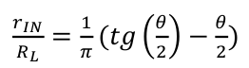
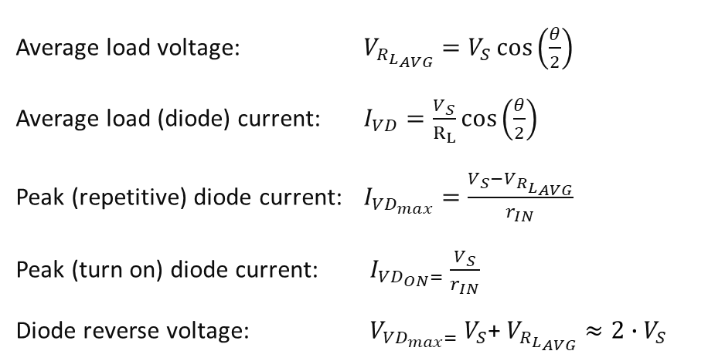
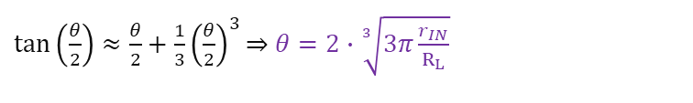
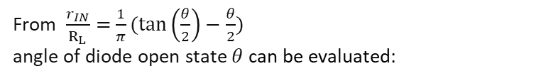
Half-Wave Rectifier with DC filter capacitor
From $\frac{r_{IN}}{R_{L}}=$ $\frac{1}{π}(tan\left(\frac{θ}{2}\right)−\frac{θ}{2})$
angle of diode open state $θ$ can be evaluated:
$$V$$
$$v_{R_{L}}(t)$$
$\tan\left(\frac{θ}{2}\right)≈\frac{θ}{2}+\frac{1}{3}{\left(\frac{θ}{2}\right)}^{3}\overset{⇒}{}$ $θ=2∙\sqrt[3]{3π\frac{r_{IN}}{R_{L}}}$
Average load voltage: $V_{{R_{L}}_{AVG}}=V_{S}\cos\left(\frac{θ}{2}\right)$
Average load (diode) current: $I_{VD}=\frac{V_{S}}{R_{L}}\cos\left(\frac{θ}{2}\right)$
Peak (repetitive) diode current: $I_{{VD}_{max}}=\frac{V_{S}−V_{{R_{L}}_{AVG}}}{r_{IN}}$
Peak (turn on) diode current: $I_{{VD}_{ON}=}$ $\frac{V_{S}}{r_{IN}}$
Diode reverse voltage: $V_{{VD}_{max}=}$ $V_{S}$+ $V_{{R_{L}}_{AVG}}≈2∙V_{S}$
$$I_{VD}(t)$$

Slide 14
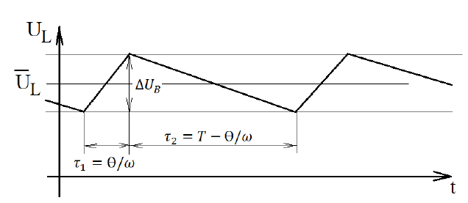
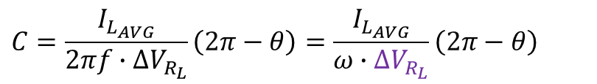
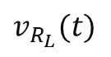

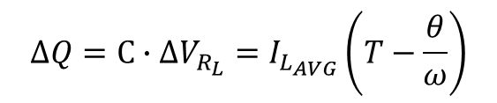
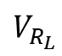

Half-Wave Rectifier with DC filter capacitor
From equation of capacitor charge on the interval of $τ_{1}<t<τ_{2}=T−\frac{θ}{ω}$
$$ΔQ=C∙ΔV_{R_{L}}=I_{L_{AVG}}\left(T−\frac{θ}{ω}\right)$$
(C)
Power filter capacitor evaluation to provide required ripple factor
$$C=\frac{I_{L_{AVG}}}{2πf∙ΔV_{R_{L}}}\left(2π−θ\right)=\frac{I_{L_{AVG}}}{ω∙ΔV_{R_{L}}}\left(2π−θ\right)$$
(F)
$$V_{R_{L}}$$
$$v_{R_{L}}(t)$$
$$V_{{R_{L}}_{AVG}}$$
$$ΔV_{R_{L}}$$

Slide 15





Center-Tap Full Wave Rectifier
Vladimir Mitkevich
BORN: 22/06/1872 (03. 08. 1872)
in MINSK, (Russian Empire,
now it’s the capital of BELARUS)
Death: 01/06/1951
Moscow, Soviet Russia
Worked in Peter the Great St.Petersburg Polytechnic University
Notes:
When we apply an AC voltage to the input transformer. During the positive half-cycle of the AC voltage, terminal 1 will be positive, center-tap will be at zero potential, and terminal 2 will be negative potential. This will lead to forwarding bias in diode D1 and cause current to flow through it. During this time, diode D2 is in reverse bias and will block current through it. During the negative half-cycle of the input AC voltage, terminal 2 will become positive relative to terminal 2 and center-tap. This will lead to forwarding bias in diode D2 and cause current to flow through it. During this time, diode D1 is in reverse bias and will block current through it.

Slide 16





Full Wave Bridge Rectifier
The Positive Half-cycle
The Negative Half-cycle
Notes:
Another type of circuit that produces the same output waveform as the full wave rectifier circuit above, is that of the Full Wave Bridge Rectifier. This type of single phase rectifier uses four individual rectifying diodes connected in a closed loop “bridge” configuration to produce the desired output. The main advantage of this bridge circuit is that it does not require a special centre-tapped transformer, thereby reducing its size and cost. The single secondary winding is connected to one side of the diode bridge network and the load to the other side as shown below. The four diodes labelled D1 to D4 are arranged in “series pairs” with only two diodes conducting current during each half cycle. During the positive half cycle of the supply, diodes D1 and D2 conduct in series while diodes D3 and D4 are reverse biased and the current flows through the load as shown below. As the current flowing through the load is unidirectional, so the voltage developed across the load is also unidirectional the same as for the previous two diode full-wave rectifier,

Slide 17

Full-Wave rectifiers (without C-filter)
Average load voltage: $V_{{R_{L}}_{AVG}}=\left\{\begin{aligned}\frac{V_{S}}{π}, \text{for} \text{HWR} \text{schemes} \\ \frac{2∙V_{S}}{π}, \text{for} \text{FBR} \text{or} \text{CTR} \text{schemes}\end{aligned}\right.$ (V)
RMS load voltage: $V_{{R_{L}}_{RMS}}=\left\{\begin{aligned}\frac{V_{S}}{2}, \text{for} \text{HWR} \text{schemes} \\ \frac{V_{S}}{\sqrt{2}}, \text{for} \text{FBR} \text{or} \text{CTR} \text{schemes}\end{aligned}\right.$(V)
Max peak diode reverse voltage: $V_{{VD}_{max}}=V_{{VD}_{max}}=\left\{\begin{aligned}{2V}_{S} for CTR scheme \\ V_{S}, for HWR and FBR schemes\end{aligned}\right.$ (V)
Average load current: $I_{L_{AVG}}=\frac{V_{{R_{L}}_{AVG}}}{R_{L}}=\left\{\begin{aligned}\frac{V_{S}}{πR_{L}}, \text{for} \text{HWR} \text{schemes} \\ \frac{2∙V_{S}}{πR_{L}}, \text{for} \text{F}\text{BR} \text{or} \text{CTR} \text{schemes}\end{aligned}\right.$ (A)
RMS load current: $I_{L_{RMS}}=\frac{V_{{R_{L}}_{RMS}}}{R_{L}}=$ $\left\{\begin{aligned}\frac{V_{S}}{2R_{L}}, \text{f}\text{or} \text{HWR} \text{schemes} \\ \frac{V_{S}}{\sqrt{2}R_{L}}, \text{for} \text{FBR} \text{or} \text{CTR} \text{schemes}\end{aligned}\right.$(A)

Slide 18

Full-Wave rectifiers (without C-filter)
Average diode rectified output current: $I_{VD}=\left\{\begin{aligned}I_{L_{AVG}}, \text{for} \text{HWR} \text{schemes} \\ \frac{I_{L_{AVG}}}{2}, \text{for} \text{FBR} \text{or} \text{CTR} \text{schemes}\end{aligned}\right.$ (A)
Peak repetitive forward output current: $I_{{VD}_{max}}=\left\{\begin{aligned}\frac{V_{S}}{R_{L}}, \text{for} \text{HWR} \text{schemes} \\ \frac{V_{S}}{2R_{L}}, \text{for} \text{FBR} \text{or} \text{CTR} \text{schemes}\end{aligned}\right.$ (A)
Voltage ripple factor: $K_{p}=\sqrt{{\left(\frac{V_{{R_{L}}_{RMS}}}{V_{{R_{L}}_{AVG}}}\right)}^{2}−1}=\left\{\begin{aligned}\sqrt{{\left(\frac{π}{2}\right)}^{2}−1}≈1.21, \text{for} \text{HWR} \text{schemes} \\ \sqrt{{\left(\frac{π}{2∙\sqrt{2}}\right)}^{2}−1}≈0.48 \text{for} \text{FBR} \text{or} \text{CTR} \text{schemes}\end{aligned}\right.$

Slide 19

Full-Wave rectifiers (with C-filter)
Source output resistance (overcurrent protection): $r_{on}= \frac{V_{S}}{I_{FSM}}$ (Ω)
Input rectifier resistance: $r_{IN}=\left\{\begin{aligned}r_{vd}+r_{V_{S}}, \text{for} \text{HWR} \text{or} \text{CTR} \text{schemes} \\ 2∙r_{vd}+r_{V_{S}}, \text{for} \text{FBR} \text{schemes}\end{aligned}\right.$ (Ω)
Diode opening state angle: $θ= \left\{\begin{aligned}2∙\sqrt[3]{3∙π∙\frac{r_{IN}}{R_{L}}}, \text{for} \text{HWR} \text{schemes} \\ 2∙\sqrt[3]{\frac{3}{2}∙π∙\frac{r_{IN}}{R_{L}}}, \text{for} \text{FBR} \text{or} \text{CTR} \text{schemes}\end{aligned}\right.$(rad)
Average load voltage $V_{{R_{L}}_{AVG}}=V_{S}∙cos\left(\frac{θ}{2}\right)= \left\{\begin{aligned}V_{S}∙cos\left(\sqrt[3]{3∙π∙\frac{r_{IN}}{R_{L}}}\right), \text{for} \text{HWR} \text{schemes} \\ V_{S}∙cos\left(\sqrt[3]{\frac{3}{2}∙π∙\frac{r_{IN}}{R_{L}}}\right), \text{for} \text{FBR} \text{or} \text{CTR} \text{schemes}\end{aligned}\right.$ (V)
Average load current: $I_{L_{AVG}}=\left\{\begin{aligned}\frac{1}{π∙r_{IN}}{(V}_{S}∙sin\left(\frac{θ}{2}\right)−V_{{R_{L}}_{AVG}}∙\frac{θ}{2}\text{)}\text{, }\text{for} \text{HWR} \text{schemes} \\ \frac{2}{π∙r_{IN}}{(V}_{S}∙sin\left(\frac{θ}{2}\right)−V_{{R_{L}}_{AVG}}∙\frac{θ}{2}\text{)}\text{,} \text{for} \text{FBR} \text{or} \text{CTR} \text{schemes}\end{aligned}\right.$ (A)

Slide 20

Full-Wave rectifiers (with C-filter)
Average diode current: $I_{VD}=\left\{\begin{aligned}\frac{V_{S}}{R_{L}}∙cos\left(\frac{θ}{2}\right)=\frac{V_{S}}{R_{L}}∙cos\left(\sqrt[3]{3∙π∙\frac{r_{IN}}{R_{L}}}\right)\text{, }\text{for} \text{HWR} \text{schemes} \\ \frac{V_{S}}{2∙R_{L}}∙cos\left(\frac{θ}{2}\right)=\frac{V_{S}}{{2∙R}_{L}}∙cos\left(\sqrt[3]{\frac{3}{2}∙π∙\frac{r_{IN}}{R_{L}}}\right), \text{for} \text{FBR} \text{or} \text{CTR} \text{sc}\text{h}\text{emes}\end{aligned}\right.$ (A)
Maximum repetitive rectifier scheme diode current: $I_{{VD}_{max}}=\frac{V_{S}−V_{{R_{L}}_{AVG}}}{r_{IN}}$ (A)
Starting (Non-repetitive) maximum peak surge diode current in rectifier scheme: $I_{{VD}_{ON}}=\frac{V_{S}}{r_{IN}}$ (A)
Peak repetitive reverse voltage: $V_{{VD}_{max}}=\left\{\begin{aligned}V_{S}+V_{{R_{L}}_{AVG}}, \text{f}\text{or} \text{HWR} \text{or} \text{CTR}\text{schemes} \\ \frac{V_{S}+V_{{R_{L}}_{AVG}}}{2}, \text{for} \text{FBR} \text{schemes}\end{aligned} \right.$ $\text{(}\text{V}\text{)}$
Capacitance evaluation: $C=\left\{\begin{aligned}\frac{I_{L_{AVG}}}{2πf∙ΔV_{R_{L}}}\left(2π−θ\right) , \text{for} \text{HWR} \text{schemes} \\ \frac{I_{L_{AVG}}}{2πf∙ΔV_{R_{L}}}\left(π−θ\right), \text{for} \text{FBR} \text{or} \text{CTR} \text{schemes}\end{aligned}\right.$ (F)
Voltage ripple: $ΔV_{R_{L}}=\left\{\begin{aligned}\frac{I_{L_{AVG}}}{2πf∙C}\left(2π−θ\right)\text{, }\text{for} \text{HWR} \text{schemes} \\ \frac{I_{L_{AVG}}}{2πf∙C}\left(π−θ\right)\text{, }\text{for} \text{FBR} \text{or} \text{CTR} \text{schemes}\end{aligned}\right.$ (V)
Voltage ripple factor $K_{p}=\sqrt{{\left(\frac{V_{{R_{L}}_{RMS}}}{V_{{R_{L}}_{AVG}}}\right)}^{2}−1}$

Slide 21

Evaluations
 | $$I_{{VD}_{AVG}}$$ | $$I_{{VD}_{max}}$$ | $$V_{{VD}_{max}}$$ | $$r_{IN}$$
Half – Wave rectifier (HWR) | $${=I}_{L_{AVG}}$$ | $$≈{7I}_{L_{AVG}}$$ | $$=V_{S}∙2≈{3V}_{{R_{L}}_{AVG}}$$ | $$=r_{VD}+r_{VS}$$
Central Tap Rectifier (CTR) | $=\frac{I_{L_{AVG}}}{2}$ | $$≈{3.5I}_{L_{AVG}}$$ | $$=V_{S}∙2≈{3V}_{{R_{L}}_{AVG}}$$ | $${=r}_{VD}+r_{VS}$$
Full bridge (Graetz) rectifier (FBR) | $$=\frac{I_{L_{AVG}}}{2}$$ | $$≈{3.5I}_{L_{AVG}}$$ | $$=V_{S}≈{1.5V}_{{R_{L}}_{AVG}}$$ | =2$r_{VD}+r_{VS}$

Slide 22


Step One: LT Spice XVII start

Slide 23


Step Two: Lab1_Rectifiers.asc
HWR
FBR
You should delete all rectifier schemes which are not your variant from template
CTR

Slide 24
Step Three: Variant data
Variant # | Rectifier scheme | Source voltage amplitude, [V] | Load resistance, [Ω] | Capacitor value [μF] | Source voltage frequency, [Hz]
 | HWR-half-wave rectifier, CTR-centrtal tap rectifier, FBR - full bridge rectifier | V_{s} | R_{L} | C_{real} | f

Slide 25


Step Four: Simulation

Slide 26

Step Five: Results

Slide 27

Step Five: Results

Slide 28


Step Five: Results

Slide 29



Step Five: Results

Slide 30








Theta issues
From equation of capacitor charge on the interval of $τ_{1}<t<τ_{2}=T−\frac{θ}{ω}$
Capacitance evaluation:
$C=\left\{\begin{aligned}\frac{I_{L_{AVG}}}{2πf∙ΔV_{R_{L}}}\left(2π−θ\right) , \text{for} \text{HWR} \text{schemes} \\ \frac{I_{L_{AVG}}}{2πf∙ΔV_{R_{L}}}\left(π−θ\right), \text{for} \text{FBR} \text{or} \text{CTR} \text{schemes}\end{aligned}\right.$ (F)
Voltage ripple:
$ΔV_{R_{L}}=\left\{\begin{aligned}\frac{I_{L_{AVG}}}{2πf∙C}\left(2π−θ\right)\text{, }\text{for} \text{HWR} \text{schemes} \\ \frac{I_{L_{AVG}}}{2πf∙C}\left(π−θ\right)\text{, }\text{for} \text{FBR} \text{or} \text{CTR} \text{schemes}\end{aligned}\right.$ (V)
$$V_{R_{L}}$$
$$v_{R_{L}}(t)$$
$$V_{{R_{L}}_{AVG}}$$
$$ΔV_{R_{L}}$$
$$τ_{1}=\frac{θ}{ω}$$

Slide 31

Theta issues
From equation of capacitor charge on the interval of $τ_{1}<t<τ_{2}=T−\frac{θ}{ω}$
Capacitance evaluation:
$C=\left\{\begin{aligned}\frac{I_{L_{AVG}}}{2πf∙ΔV_{R_{L}}}\left(2π−θ\right) , \text{for} \text{HWR} \text{schemes} \\ \frac{I_{L_{AVG}}}{2πf∙ΔV_{R_{L}}}\left(π−θ\right), \text{for} \text{FBR} \text{or} \text{CTR} \text{schemes}\end{aligned}\right.$ (F)
Voltage ripple:
$ΔV_{R_{L}}=\left\{\begin{aligned}\frac{I_{L_{AVG}}}{2πf∙C}\left(2π−θ\right)\text{, }\text{for} \text{HWR} \text{schemes} \\ \frac{I_{L_{AVG}}}{2πf∙C}\left(π−θ\right)\text{, }\text{for} \text{FBR} \text{or} \text{CTR} \text{schemes}\end{aligned}\right.$ (V)
If currents are less 1A it is better to use open –state current value al least 100mA to determine theta from simulation
$$V_{R_{L}}$$
$$v_{R_{L}}(t)$$
$$V_{{R_{L}}_{AVG}}$$
$$ΔV_{R_{L}}$$
$$τ_{1}=\frac{θ}{ω}$$

Slide 32


Step Five: Results

Slide 33
Step Five: Results
Conclusions should contain:
Diode check results:
Is breakdown voltage check passed? /Is voltage source changed because of overvoltage?
Is starting current check passed? /Is additional resistance r_vs added to prevent overcurrent in diode/capacitor?
Capacitor information: nominal value, tolerance, allowed current
Provided ripple factor value

Slide 34
Step Five: Results
Conclusion should contain:
Diode check results:
Is breakdown voltage check passed? Is voltage source changed because of overvoltage?
Is starting current check passed? /Is additional resistance r_vs added to prevent overcurrent in diode/capacitor?
Capacitor information: nominal value, tolerance, allowed current
Ripple factor value
If there are no conclusion or some parts o conclusion is missing – the score will be reduced by 1 point of 3

Slide 35
Practice task 1 Simple semiconductor device circuits design
Nikolai Poliakov (polyakov_n_a@itmo.ru)
Arina Arbuzina (arbyzina99@gmail.com)

Slide 36

Diode active resistance
Maximum repetitive peak surge forward current
$I_{fwd_imp}=$ (A)
Diode forward bias voltage
$V_{fwd_max}\left(I_{fwd_imp}\right)=$ (V)
Diode threshold voltage:
$v_{ON}=$ (V)
Diode current at starting conduct state:
$I_{fwd}\left(v_{ON}\right)=$ (A)
Diode active resistance:
$r_{VD}= \frac{V_{fwd_max}−v_{ON}}{I_{fwd_{imp} − I_{fwd}\left(v_{ON}\right)}}=$ (Ω)
Notes:
One of the main parameters of a diode is the Diode active resistance under forward bias. The easiest way to calculate the resistance of a diode is from its current-voltage characteristics. Consider the forward branch of the diode. Let's mark two points on it - voltage and current, at which the diode turns off and the maximum allowable repetitive peak surge forward current value and the corresponding voltage. The diode resistance will be calculated as the ratio of the voltage difference to the corresponding current difference.

Slide 37


Evaluations
 | $$I_{{VD}_{AVG}}$$ | $$I_{{VD}_{max}}=$$ $$I_{fwd_imp}$$ | $$V_{{VD}_{max}}$$ | $$r_{IN}$$
Half – Wave rectifier (HWR) | $${=I}_{L_{AVG}}$$ | $$≈{7I}_{L_{AVG}}$$ | $$=V_{S}∙2≈{3V}_{{R_{L}}_{AVG}}$$ | $$=r_{VD}+r_{VS}$$
Central Tap Rectifier (CTR) | $=\frac{I_{L_{AVG}}}{2}$ | $$≈{3.5I}_{L_{AVG}}$$ | $$=V_{S}∙2≈{3V}_{{R_{L}}_{AVG}}$$ | $${=r}_{VD}+r_{VS}$$
Full bridge (Graetz) rectifier (FBR) | $$=\frac{I_{L_{AVG}}}{2}$$ | $$≈{3.5I}_{L_{AVG}}$$ | $$=V_{S}≈{1.5V}_{{R_{L}}_{AVG}}$$ | =2$r_{VD}+r_{VS}$
$$I_{{VD}_{AVG}(experimental)}$$

Slide 38






Diode active resistance
Maximum repetitive peak surge forward current
$I_{fwd_imp}=40$ (A)
Diode forward bias voltage
$V_{fwd_max}\left(I_{fwd_imp}\right)=1.0$ (V)
Diode threshold voltage:
$v_{ON}=0.35$ (V)
Diode active resistance:
$r_{VD}= \frac{V_{fwd_max}−v_{ON}}{I_{fwd_{imp} − I_{fwd}\left(v_{ON}\right)}}$ (Ω)
$$I_{fwd_imp}$$
$$v_{ON}$$
$$I_{fwd_imp}$$
$$v_{ON}$$
Notes:
One of the main parameters of a diode is the Diode active resistance under forward bias. The easiest way to calculate the resistance of a diode is from its current-voltage characteristics. Consider the forward branch of the diode. Let's mark two points on it - voltage and current, at which the diode turns off and the maximum allowable repetitive peak surge forward current value and the corresponding voltage. The diode resistance will be calculated as the ratio of the voltage difference to the corresponding current difference.

Slide 39

Diode active resistance
$$I_{fwd_imp}$$
Maximum repetitive peak surge forward current
$I_{fwd_imp}=10$ (A)
Diode forward bias voltage
$V_{fwd_max}\left(I_{fwd_imp}\right)=1.05$ (V)
Diode threshold voltage:
$v_{ON}=0.68$ (V)
$$v_{ON}$$
$$I_{fwd_imp}$$
$$v_{ON}$$
Notes:
One of the main parameters of a diode is the Diode active resistance under forward bias. The easiest way to calculate the resistance of a diode is from its current-voltage characteristics. Consider the forward branch of the diode. Let's mark two points on it - voltage and current, at which the diode turns off and the maximum allowable repetitive peak surge forward current value and the corresponding voltage. The diode resistance will be calculated as the ratio of the voltage difference to the corresponding current difference.

Slide 40

Diode active resistance
Maximum repetitive peak surge forward current
$I_{fwd_imp}=40$ (A)
Diode forward bias voltage
$V_{fwd_max}\left(I_{fwd_imp}\right)=1.0$ (V)
Diode threshold voltage:
$v_{ON}=0.35$ (V)
Diode active resistance:
$r_{VD}= \frac{V_{fwd_max}−v_{ON}}{I_{fwd_{imp} − I_{fwd}\left(v_{ON}\right)}}$ (Ω)
$r_{VD}= \frac{1−0.35}{40−0.1}=$ 0.0163 Ω
Notes:
let's check the correctness of the solution. Maximum repetitive peak surge forward current for our point is equals to 40 A. The diode forward bias voltage corresponding to this current is equal to 1 V. Diode threshold voltage for diode is equals to 0,35 V and corresponding current to 0,1 A. Substituting all the numbers in the formula, we get that the Diode active resistance is equal to 0.0163 Ohm

Slide 41


Diode VI in LT Spice
Maximum repetitive peak surge forward current
$I_{fwd_imp}=$ (A)
Diode forward bias voltage
$V_{fwd_max}\left(I_{fwd_imp}\right)=$ (V)
Diode threshold voltage:
$v_{ON}=$ (V)
Diode active resistance:
$r_{VD}= \frac{V_{fwd_max}−v_{ON}}{I_{fwd_{imp} − I_{fwd}\left(v_{ON}\right)}}$ (Ω)
$r_{VD}= \frac{}{}=$ Ω
Notes:
let's check the correctness of the solution. Maximum repetitive peak surge forward current for our point is equals to 40 A. The diode forward bias voltage corresponding to this current is equal to 1 V. Diode threshold voltage for diode is equals to 0,35 V and corresponding current to 0,1 A. Substituting all the numbers in the formula, we get that the Diode active resistance is equal to 0.0163 Ohm

Slide 42



Diode active resistance
Maximum repetitive peak surge forward current
$I_{fwd_imp}=7$ (A)
Diode forward bias voltage
$V_{fwd_max}\left(I_{fwd_imp}\right)=1.2$ (V)
Diode threshold voltage:
$v_{ON}=0.75$ (V)
Diode active resistance:
$r_{VD}= \frac{V_{fwd_max}−v_{ON}}{I_{fwd_{imp} − I_{fwd}\left(v_{ON}\right)}}$ (Ω)
$r_{VD}= \frac{1.2−0.75}{7−0.1}=$ 0,065 Ω
$$I_{fwd_imp}$$
$$v_{ON}$$
$$V_{fwd_max}\left(I_{fwd_imp}\right)$$
$$I_{fwd_imp}$$
$$v_{ON}$$
$$V_{fwd_max}\left(I_{fwd_imp}\right)$$
Notes:
let's check the correctness of the solution. Maximum repetitive peak surge forward current for our point is equals to 40 A. The diode forward bias voltage corresponding to this current is equal to 1 V. Diode threshold voltage for diode is equals to 0,35 V and corresponding current to 0,1 A. Substituting all the numbers in the formula, we get that the Diode active resistance is equal to 0.0163 Ohm

Slide 43

Diode active resistance
$$I_{fwd_imp}$$
$$v_{ON}$$
$$V_{fwd_max}\left(I_{fwd_imp}\right)$$
$$I_{fwd_imp}$$
$$v_{ON}$$
$$V_{fwd_max}\left(I_{fwd_imp}\right)$$
Notes:
let's check the correctness of the solution. Maximum repetitive peak surge forward current for our point is equals to 40 A. The diode forward bias voltage corresponding to this current is equal to 1 V. Diode threshold voltage for diode is equals to 0,35 V and corresponding current to 0,1 A. Substituting all the numbers in the formula, we get that the Diode active resistance is equal to 0.0163 Ohm

Slide 44


Step Five: Submit practice results form before 1.10.2023!!
Laboratory Work 1
Practice task 1
https://forms.yandex.com/cloud/6500ee1702848f28e1856a23/
https://clck.ru/35gixy
https://forms.yandex.com/cloud/650103e590fa7b299554a509/
https://clck.ru/35giyD

Slide 45
Thank you for your attention!

